Slide 1

Day - 1
Introduction to OData
Why we need OData
Benefits of OData
What is REST ?
OData Calls – GET Sample SAP OData
How to Enable Gateway
Define System Alias
Important TCode’s
Describing Postman Tool
Understanding How to Use Postman
Describing EPM Data Model
Creating OData services with the SAP NetWeaver Gateway Service Builder

Slide 2
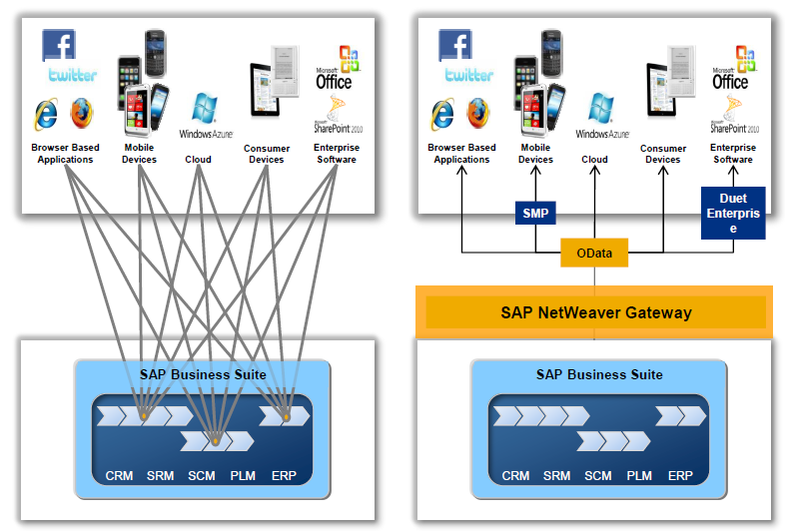
Introduction to OData
OData is open data protocol, it is used to create REST based services, initially developed by the OASIS (Organization for the Advancement of Structured Information Standards) company later acquired by Microsoft and make open source.
The simplest definition of OData would be that it is a standardized protocol built over existing HTTP and REST protocols supporting CRUD (Create, Read, Update, Delete) operations for creating and consuming data APIs.
Currently OData is widely used for exposing data.
Introduction
01
Software Innovation
02
Hardware Innovation

Slide 3
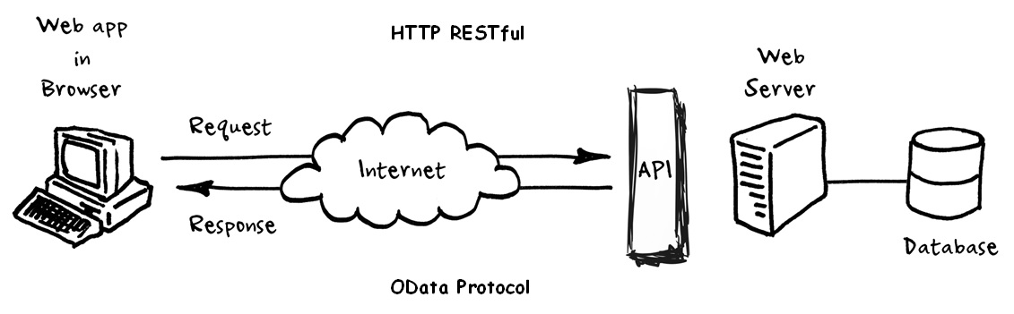
Why we need OData
OData helps you focus on your business logic while building RESTful APIs without having to worry about the various approaches to define request and response headers, status codes, HTTP methods, URL conventions, media types, payload formats, query options, etc.
OData (Open Data Protocol) is an ISO/IEC approved, OASIS standard that defines a set of best practices for building and consuming RESTful APIs.
OData also provides guidance for tracking changes, defining functions/actions for reusable procedures, and sending asynchronous/batch requests.
OData RESTful APIs are easy to consume. The OData metadata, a machine-readable description of the data model of the APIs, enables the creation of powerful generic client proxies and tools.
Introduction
01
02
Hardware Innovation

Slide 4
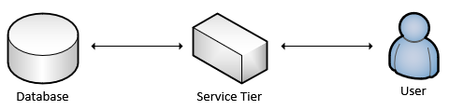
Benefits of OData
OData is able to provide metadata about your service interface that can be used to generate client code to access the service. So if you have lots of client classes that you need to create, this could speed up your process.
It lets developers interact with data by using RESTful web services.
It provides a simple and uniform way to share data in a discoverable manner.
It enables broad integration across products.
It enables integration by using the HTTP protocol stack.
01
Software Innovation
02
Hardware Innovation

Slide 5
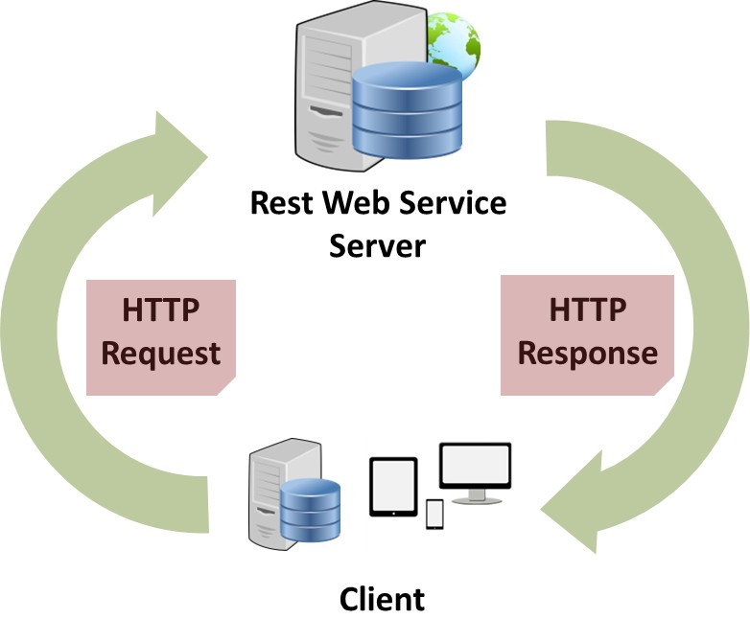
What is Rest?
A REST API (also known as RESTful API) is an application programming interface (API or web API) that conforms to the constraints of REST architectural style and allows for interaction with RESTful web services. REST stands for representational state transfer and was created by computer scientist Roy Fielding.
REST is defined as an option for web services and Remote Procedure calls. It is used for designing network applications.
REST services like a web services and supports below features −
Work with firewalls
Language-independent
Standards-based
Not Platform dependent
Code on Demand
Introduction
01
02

Slide 6
OData Calls – Get Sample OData
Sample OData Service
https://services.odata.org/V2/Northwind/Northwind.svc/?$format=json
Sets the page size of results.
02
$top
Indexes into a result set. Also used by some APIs to implement paging and can be used together with $top to manually page results.
Returns the results in the specified media format.
01
03
$format
$skip
ODATA Query
01
06
04
Filters properties (columns).
Retrieves related resources.
$select
$expand
05
$filter
Filters results (rows).

Slide 7
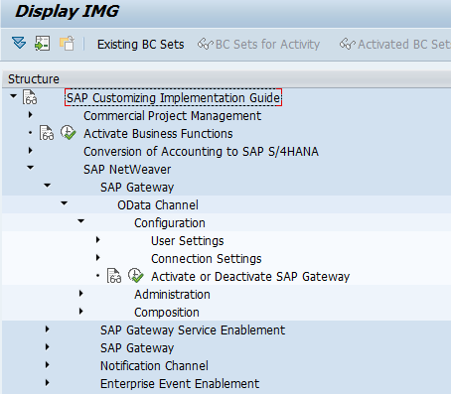
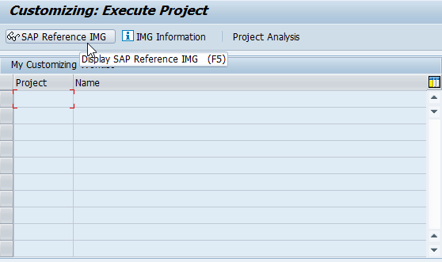
Steps for Enable SAP Gateway
Go to SPRO >> SAP Reference IMG.
Expand SAP NetWeaver >> Gateway >> ODATA Channel >> Configuration >> Activate or Deactivate SAP NetWeaver Gateway.
Click on Activate or Deactivate button to activate or deactivate SAP NetWeaver Gateway. In this case gateway is already activated.
01
Software Innovation
02
Hardware Innovation

Slide 8
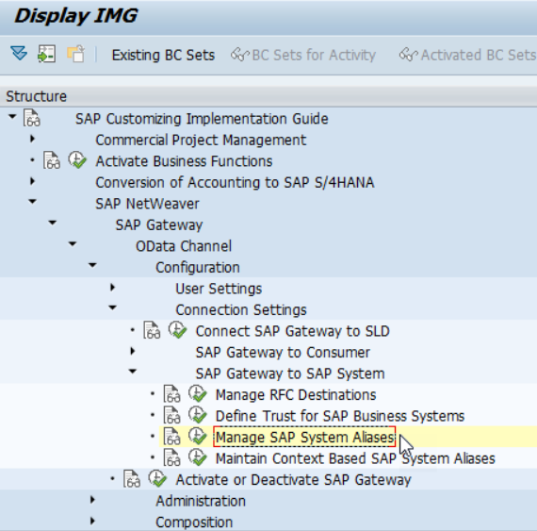
Define System Alias
Aliases are names that system administrators define for each system they create so that portal components can reference these systems. They are a means of retrieving the information stored on database servers without having to know the name of the server.
Procedure:
Use transaction SPRO
>>> SAP Reference IMG SAP Customizing Imp Guide
>>> SAP NetWeaver
>>> Gateway OData Channel
>>> Configuration
>>> Connection Settings
>>> Manage SAP System Aliases to OData Service.
Choose New Entries and enter the following:
Click Save to save your configuration settings.
01

Slide 9
Important TCode's
SEGW – Service Builder
/N/IWFND/MAINT_SERVICE – Maint Service / Registration of services
/N/IWFND/ERROR_LOG – Error logs of service calls
/N/IWFND/GW_CLIENT – Client Gateway / Test services locally within sap system
/N/IWFND/CACHE_CLEANUP - Cache Cleanup
02

Slide 10

Describing Postman Tool
Postman is an interactive and automatic tool for verifying the APIs of your project. Postman is a Google Chrome app for interacting with HTTP APIs. It presents you with a friendly GUI for constructing requests and reading responses. ... Postman is the way to streamline the process of API testing.
Postman is an API platform for building and using APIs. Postman simplifies each step of the API lifecycle and streamlines collaboration so you can create better APIs—faster.
Postman can run GET, POST, PUT, PATCH, MERGE, DELETE, and various other request methods as well, and also has utilities to help with developing APIs. Free and paid versions are available for Mac, Windows, Linux, and also as a Chrome app.
01
02
Hardware Innovation

Slide 11
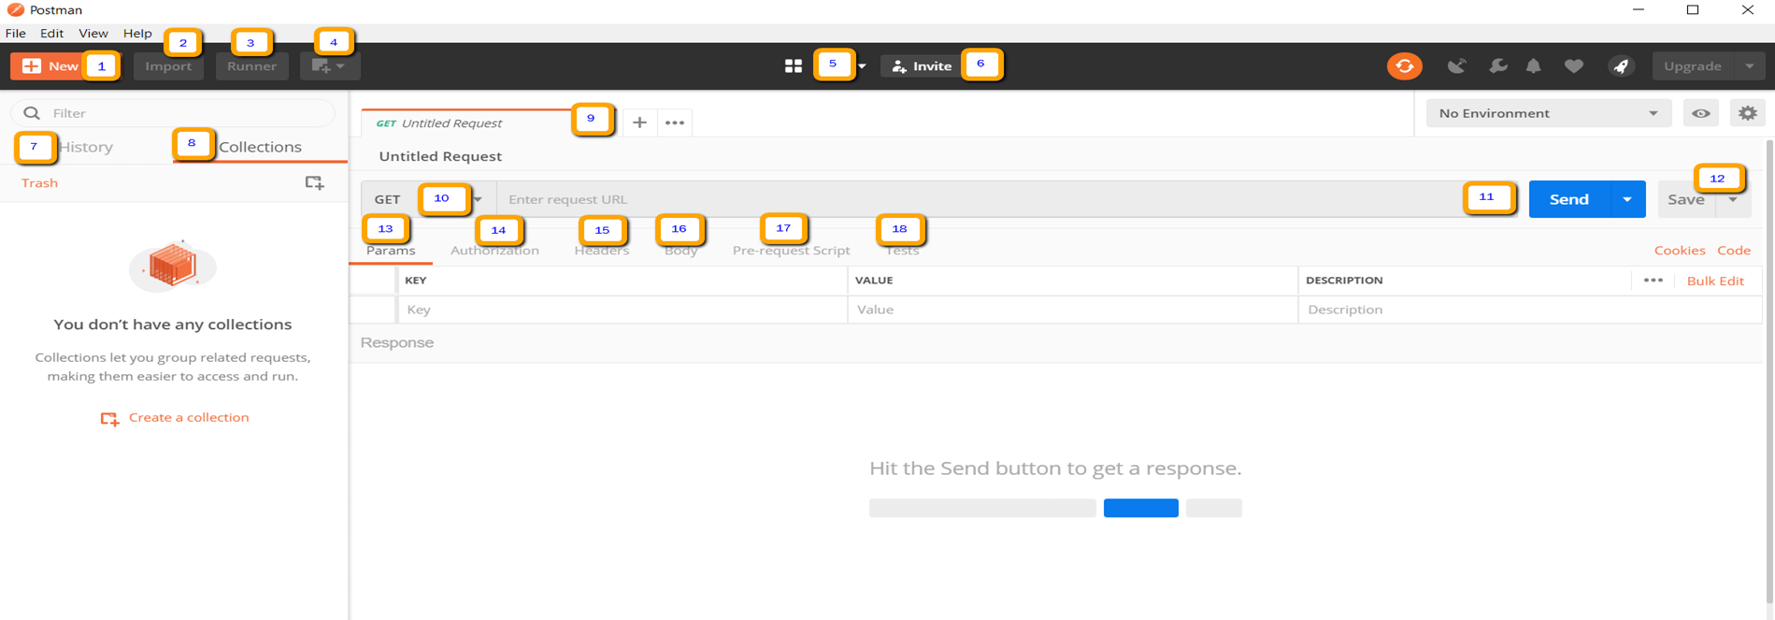
Steps for Perform Operation
Launch the Postman tool app.
Open the “Choose by User” template.
Select the “Choose by User” in the HTTP methods dropdown.
Pass the request URI in the address bar of Postman.
Pass request payload
Add authorization if applicable.
Add headers if applicable.
Click on the “Send” button.
View the response body and other details.
01
02
Hardware Innovation

Slide 12
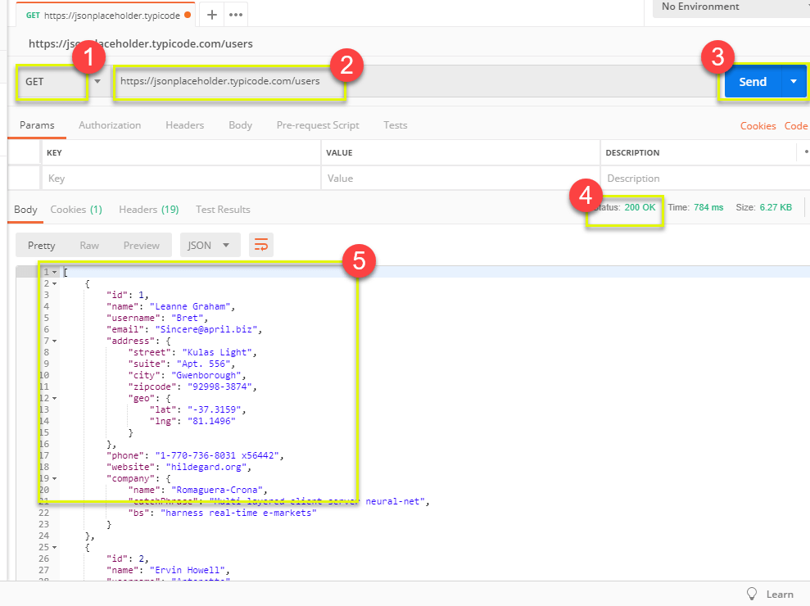
Understanding How to Use Postman
Get requests are used to retrieve information from the given URL. There will be no changes done to the endpoint.
We will use the following URL for all examples in this Postman tutorial
Introduction
02

Slide 13
EPM Data Model
Real-time like demo data model which includes database tables, FMs, classes, Scenarios for training purpose and very much similar to real-life.
Products
Texts
Purchase Order Header
Items
100 Laptops
300 HDD
50 Projectors
….
Sales Order Header
Items
10 Laptops
3 HDD
5 Projectors
ITeIO
Electronics goods supplier (Amazon)
Introduction
Customers (BP)
Suppliers (BP)
Invoice
Invoice Items
6 laptop
3 HDD
2 Projector
01
Software Innovation
Stock
Invoice Line Item <= Sales Order Line item
6 laptop
3 HDD
2 Projector
02

Slide 14
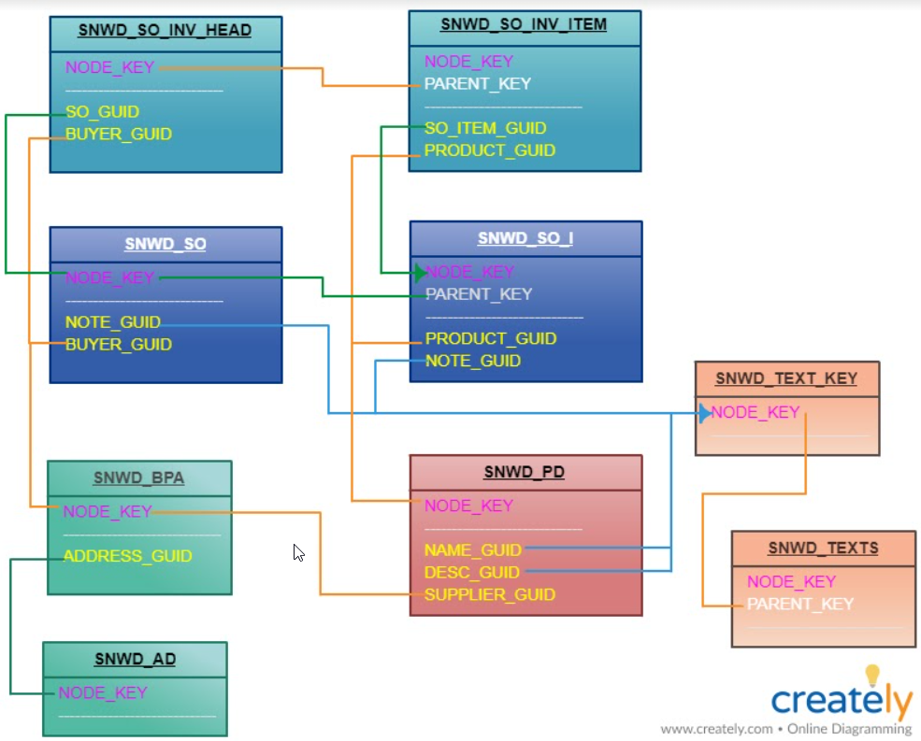
Important Tables for EPM
SNWD_PD – Products
SNWD_TEXTS – Product Descriptions
SNWD_BPA – Business Partners
SNWD_AD – BP Addresses
SNWD_SO – Sales orders
SNWD_SO_I – Sales Order Items
SNWD_SO_INV_HEAD – Invoice header
SNWD_SO_INV_ITEMS – Invoice items
….
Introduction
01
02

Slide 15
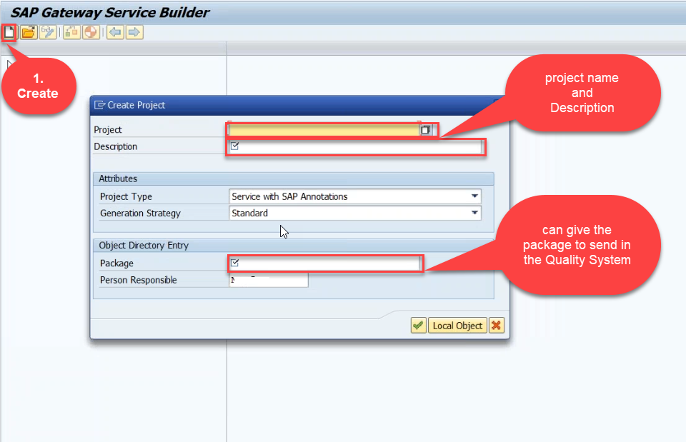
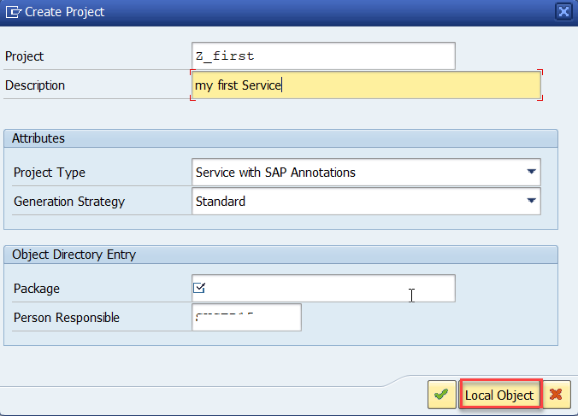
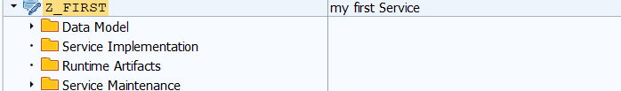
Creating OData Service
Step1: Start your SAP LOGON, and to Sap Gateway Service Builder(SEGW) and click on Create
Introduction
01
Software Innovation
02
Hardware Innovation

Slide 16
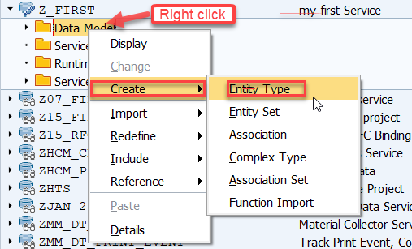
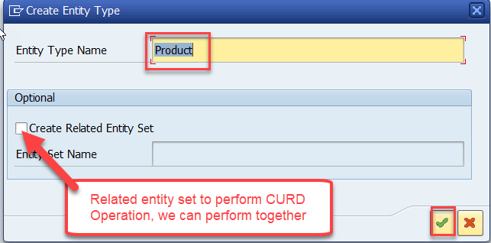
Creating OData Service
Step2: Defining the Data Model (Blue print of data)
01
02

Slide 17
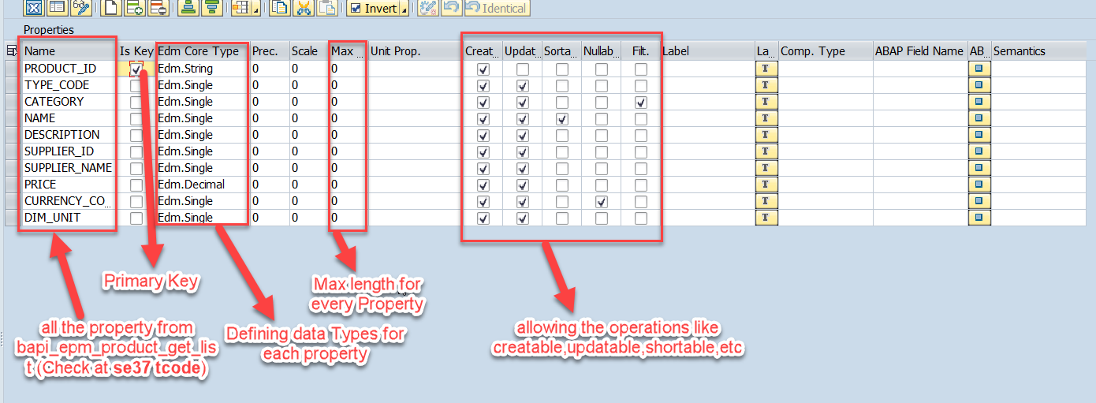
Creating OData Service
Step3: Creating Properties for data model (from bapi_epm_product_get_list (tcode- se37))
01
Software Innovation
02
Hardware Innovation

Slide 18
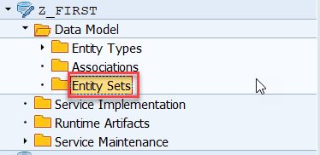
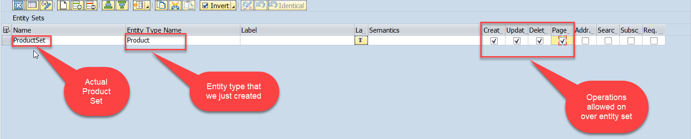
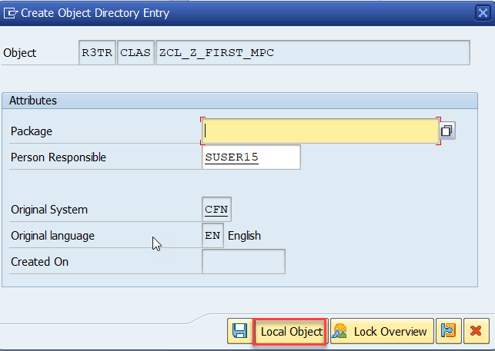
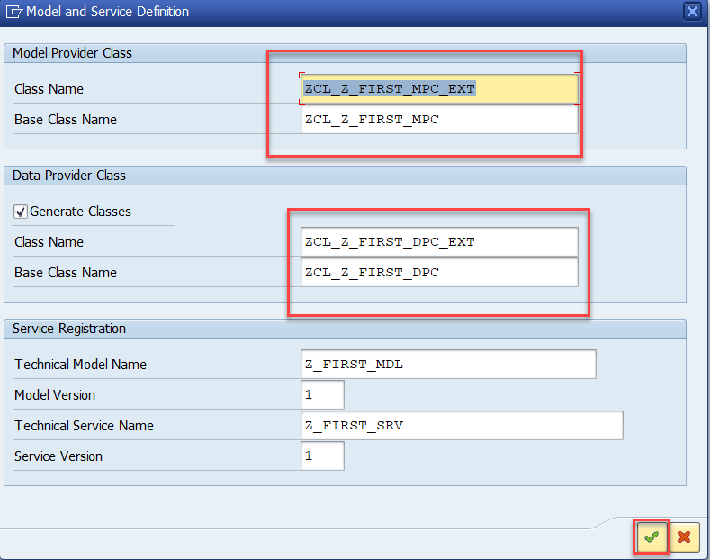

Creating OData Service
Step4: Creating entity set to perform actual CURD operations and service generation
01
Software Innovation
02
Hardware Innovation

